Slide 1
EMPLOYEE MANAGEMENT SYSTEM USING JDBC CRUD OPERATION
NAME: ANKUR
ENROLLEMENT ID: EBEON0322398659

Slide 2
What is Ems
It maintains the information about the personal and offical details of employee.
EMS is a distributed system to maintan the details of the Employee

Slide 3
Objective of our project
Aim: To Perform CRUD operations in IDE (Eclipse) by using MySQL database and java JDBC
Requirement
JDK
ECLIPSEIDE
MYSQL WORKBENCH
MYSQL JDBC DRIVER

Slide 4
PROCEDURE
IEMPLOYEEDAO
IEMPLOYEESERVICE
EMPLOYEE
EMPLOYEESERVICEOPL
employeedaodaomysqlipl
employeeMain
EMPLOYEENOTFOUND EXCEPTION

Slide 5
SOFTWARE DESIGN
• Create a Database
Create a Table – EmployEE
Load the JDBCdriver in your java program by using Driver Class Name •
The loaded class will throw Exception So Surround the Class.forName() with try-catch block.
Fist of all create a dto class mean to create data transfer object with class name Employee where we can create employee variable name getters and setters and constuctorrs

Slide 6
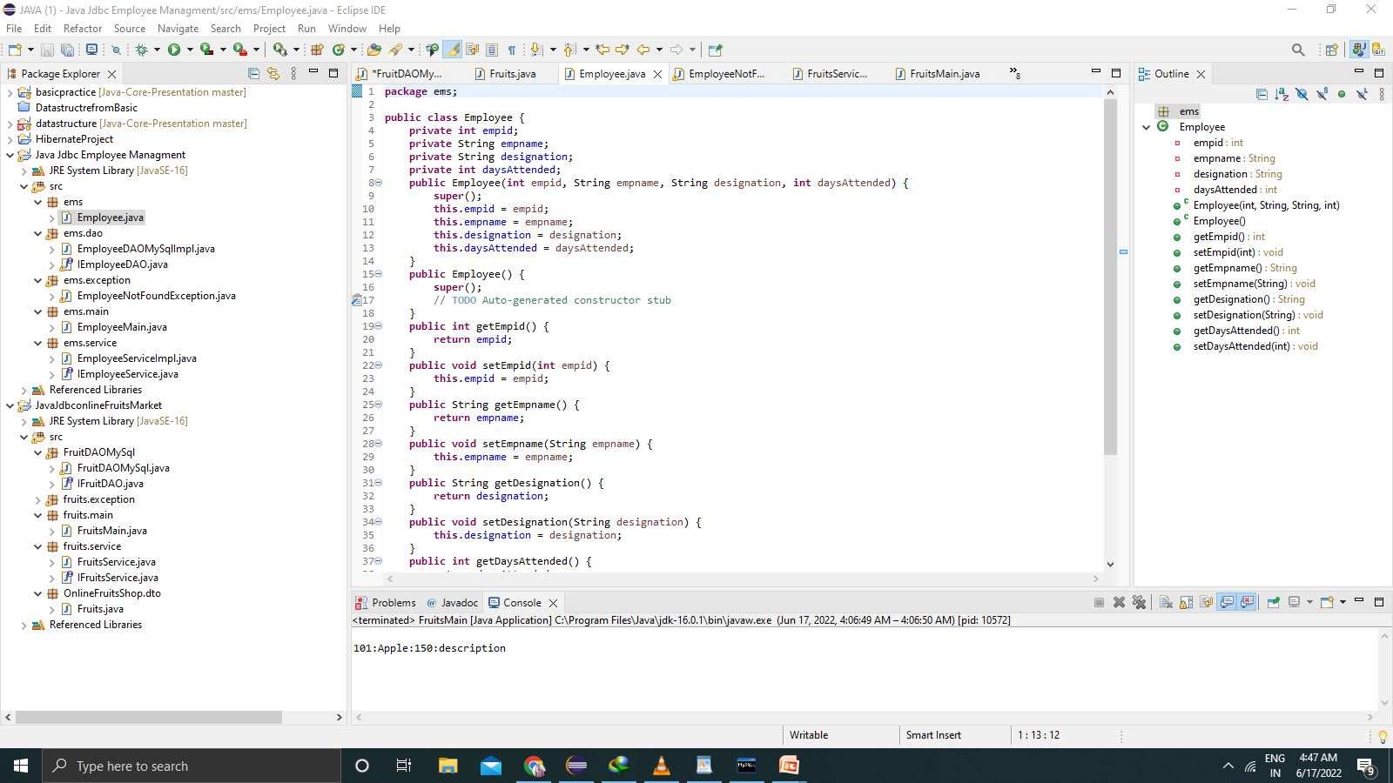
DTO USING CLASS NAME EMPLOYEE

Slide 7
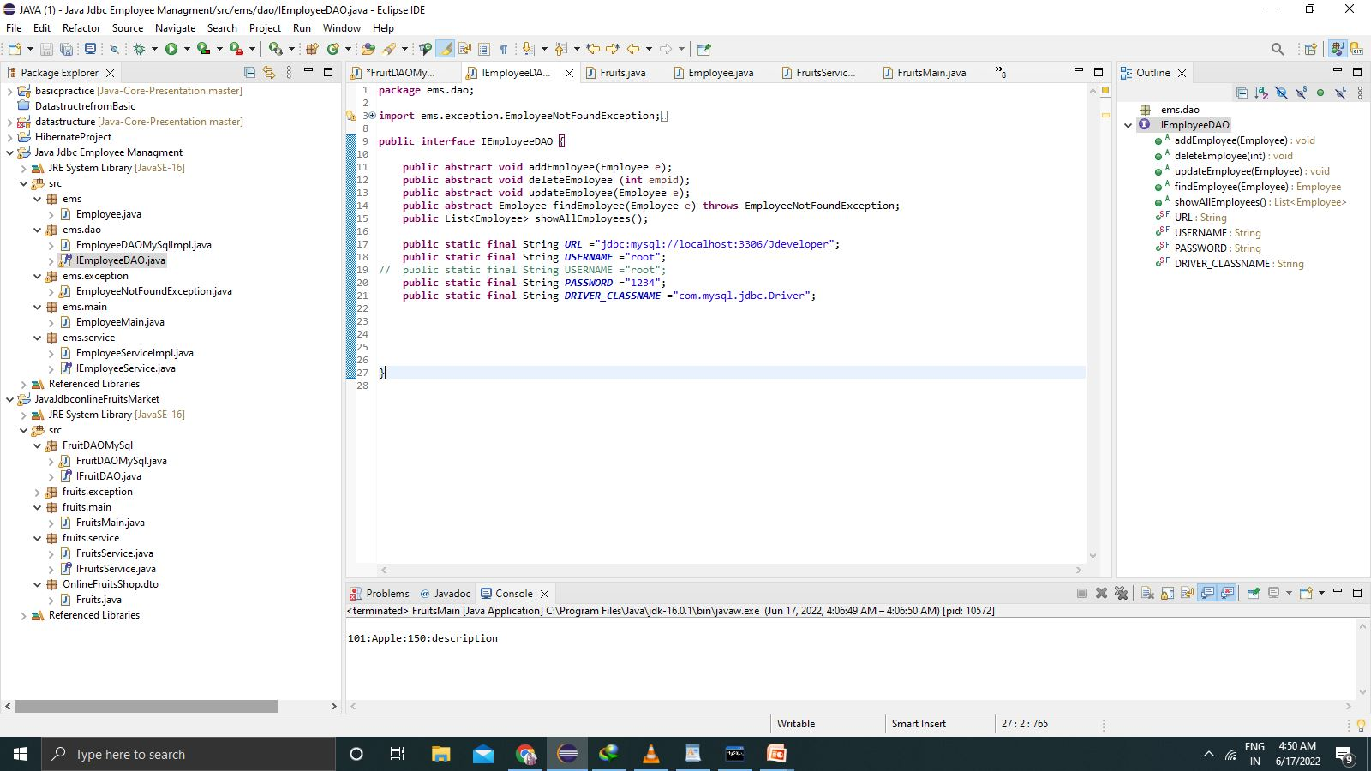
Then make a employeedao package and interface of employeeDaointerface and there service

Slide 8
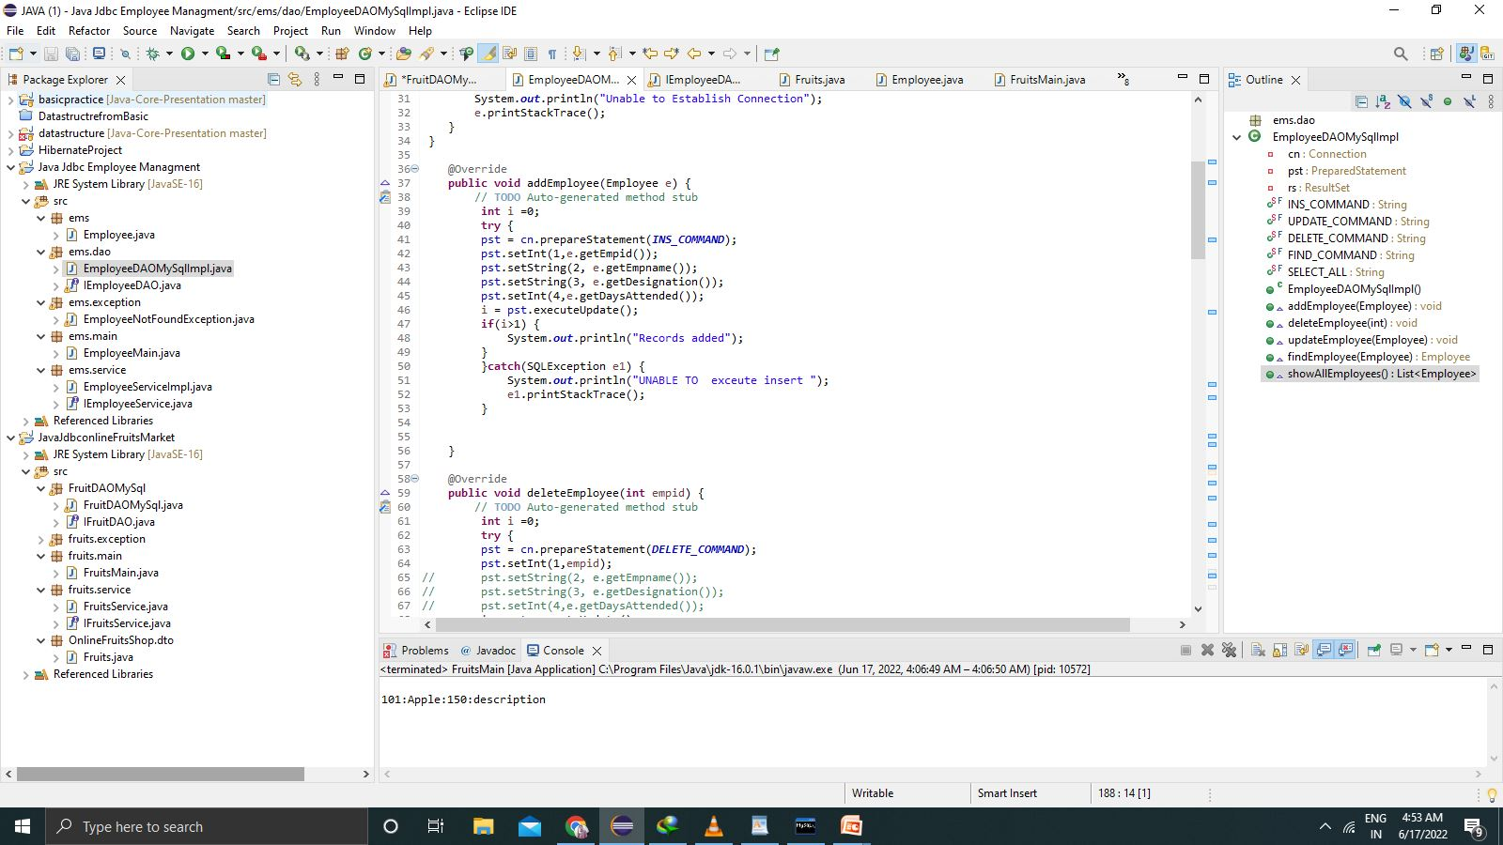
After that the method of these object using crud operation

Slide 9
After that the service we create Service Package because Service Package is used to Decouple the DAO package from the main method code
After that the employee main class name using EmployeeMain

Slide 10
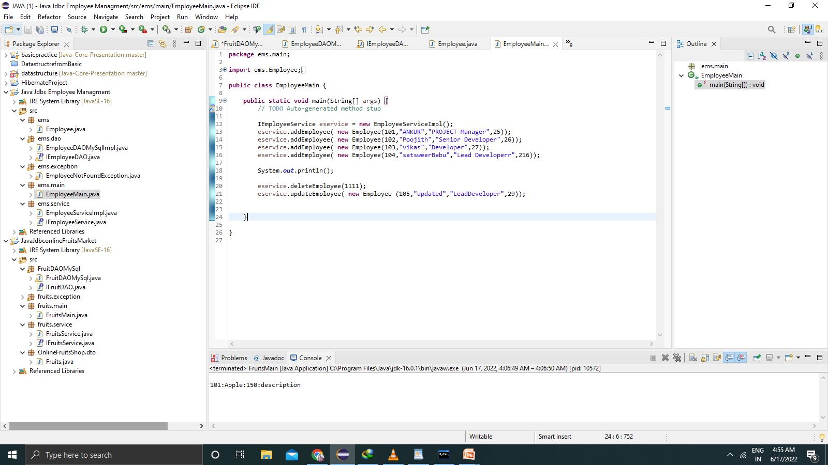

Slide 11
Limitations
This is a simple JDBC CRUD OPERATION FOR MAKING THE ADD EMPLOYEE, DELETE EMPLYEE UPDATE EMPLOYEE FROM DATABASE
It requires a JDBC CONNECTIONS

Slide 12
THANK YOU

